Slide 1

Commboard Transmission System (“CMBTL”)
By: Alaric Jenkins

Slide 2
CMBTL Motivation
Store sensor data in a consistent but extensible way
Many sensors have very similar funcitionality, implement DRY (“Don’t Repeat Yourself”) philosophy. Uses Template Metaprogramming (“TMP”) to achieve this
Implement functionality to compress sensor data, useful for bandwidth-constrained competition settings

Slide 3
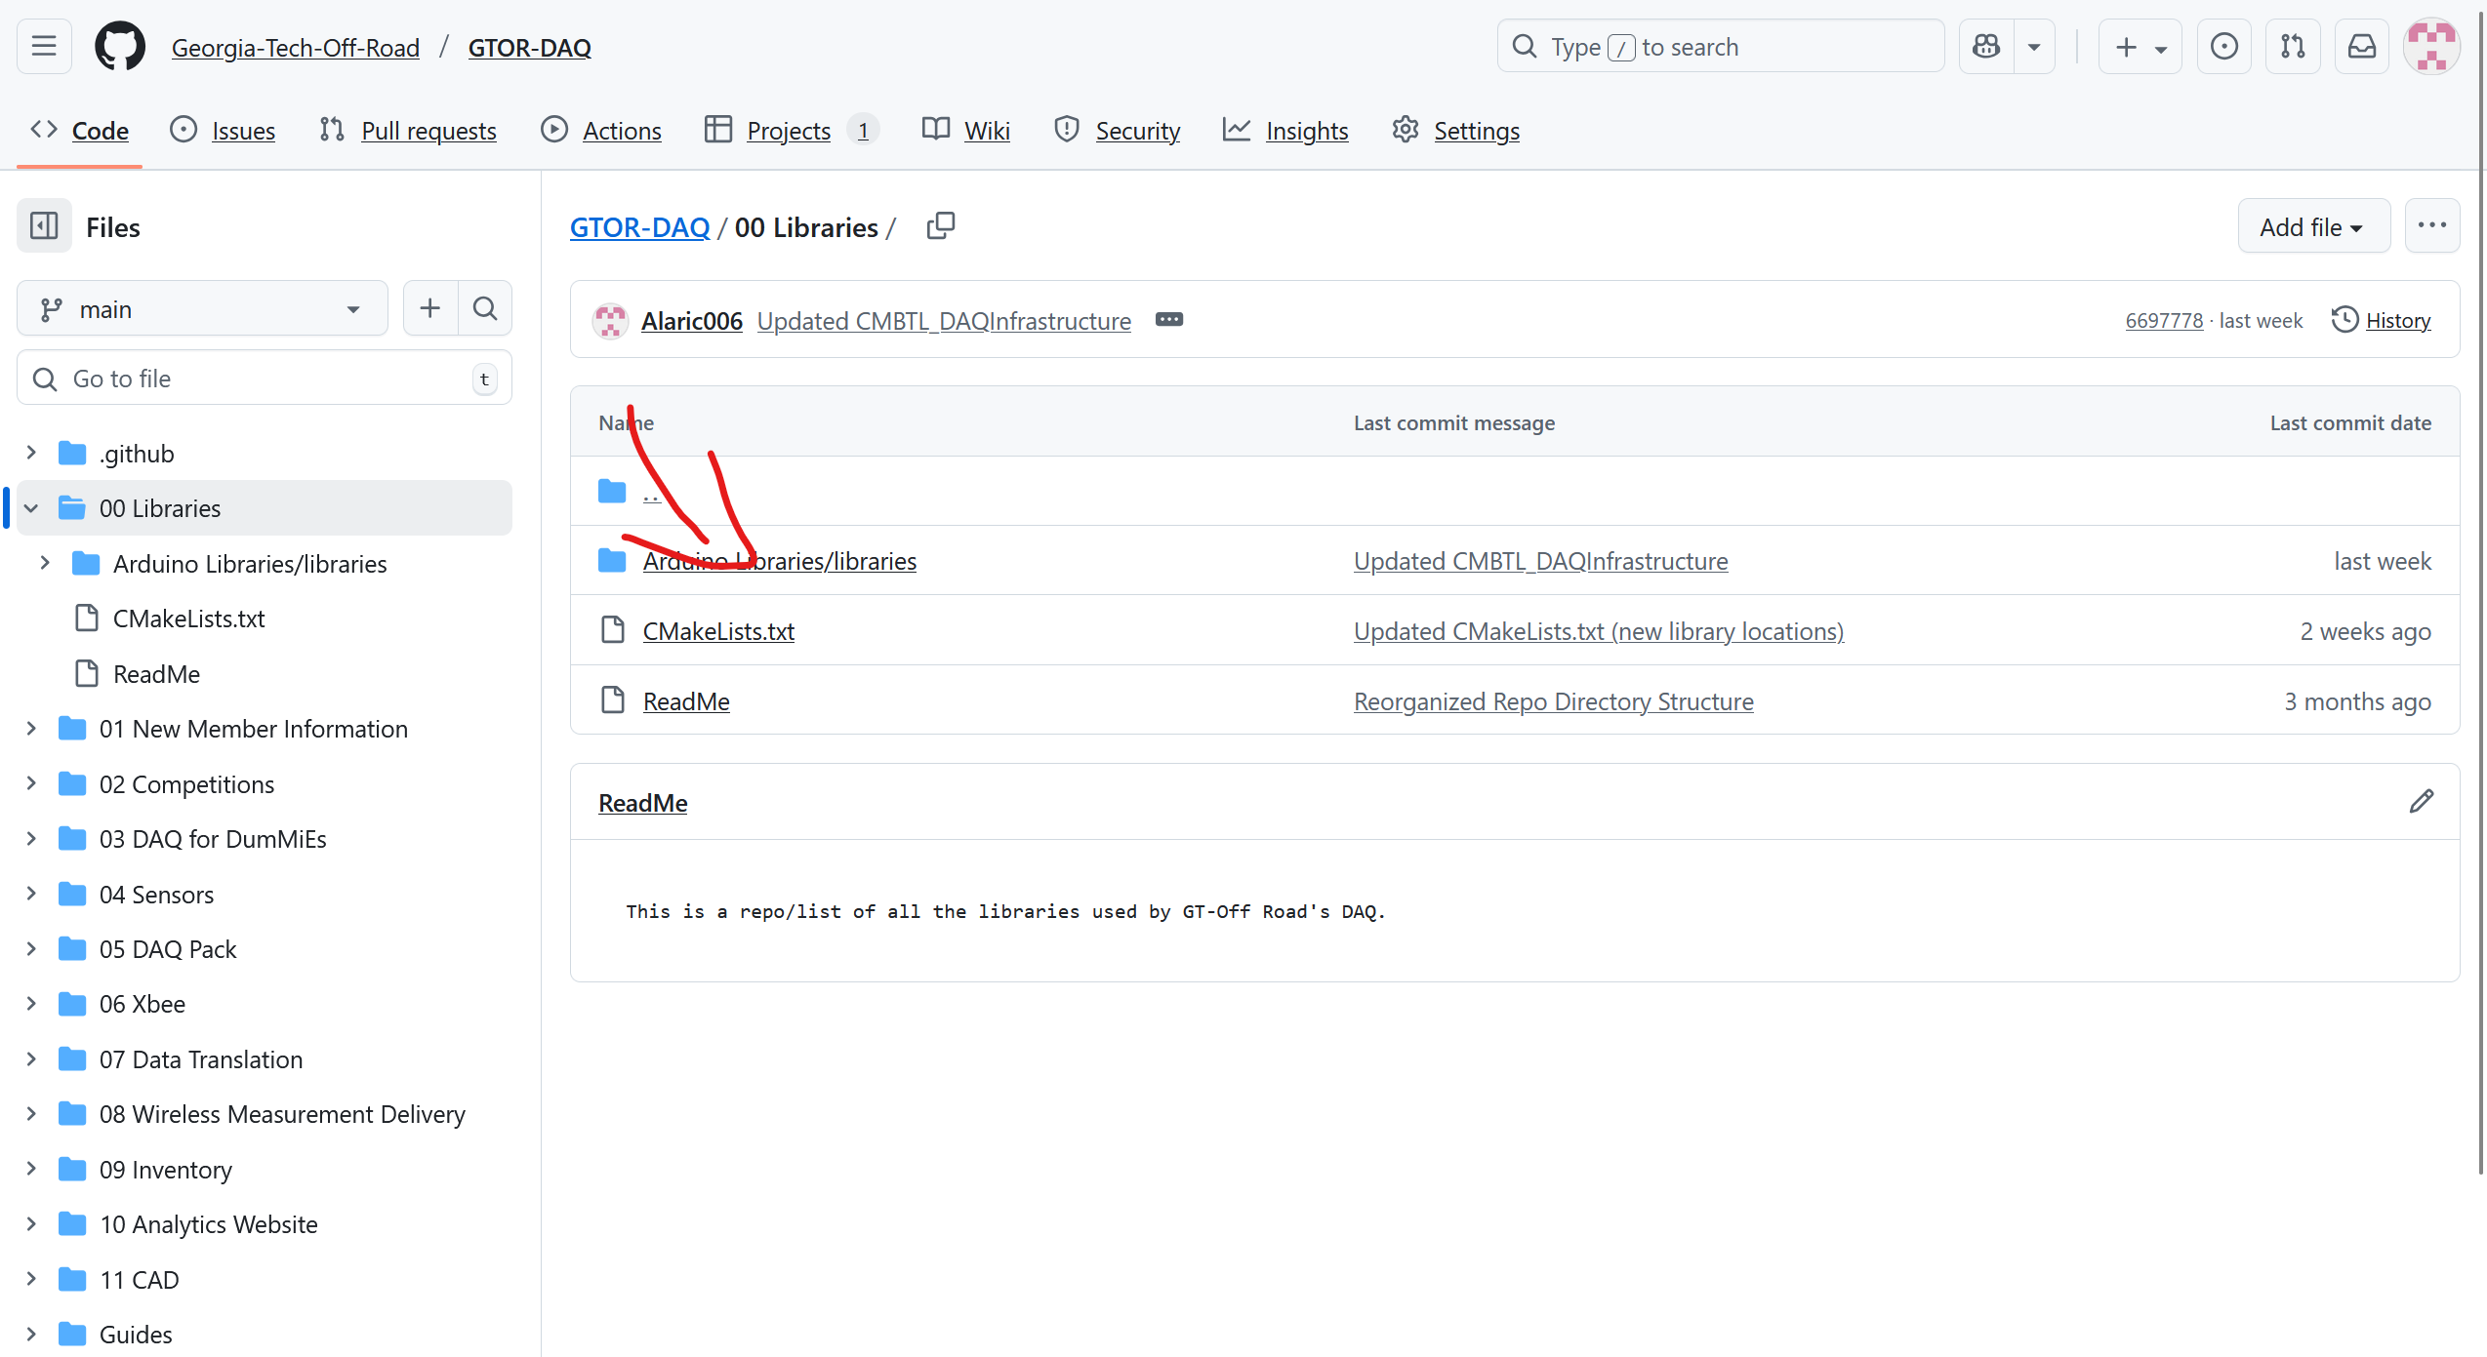

Slide 4
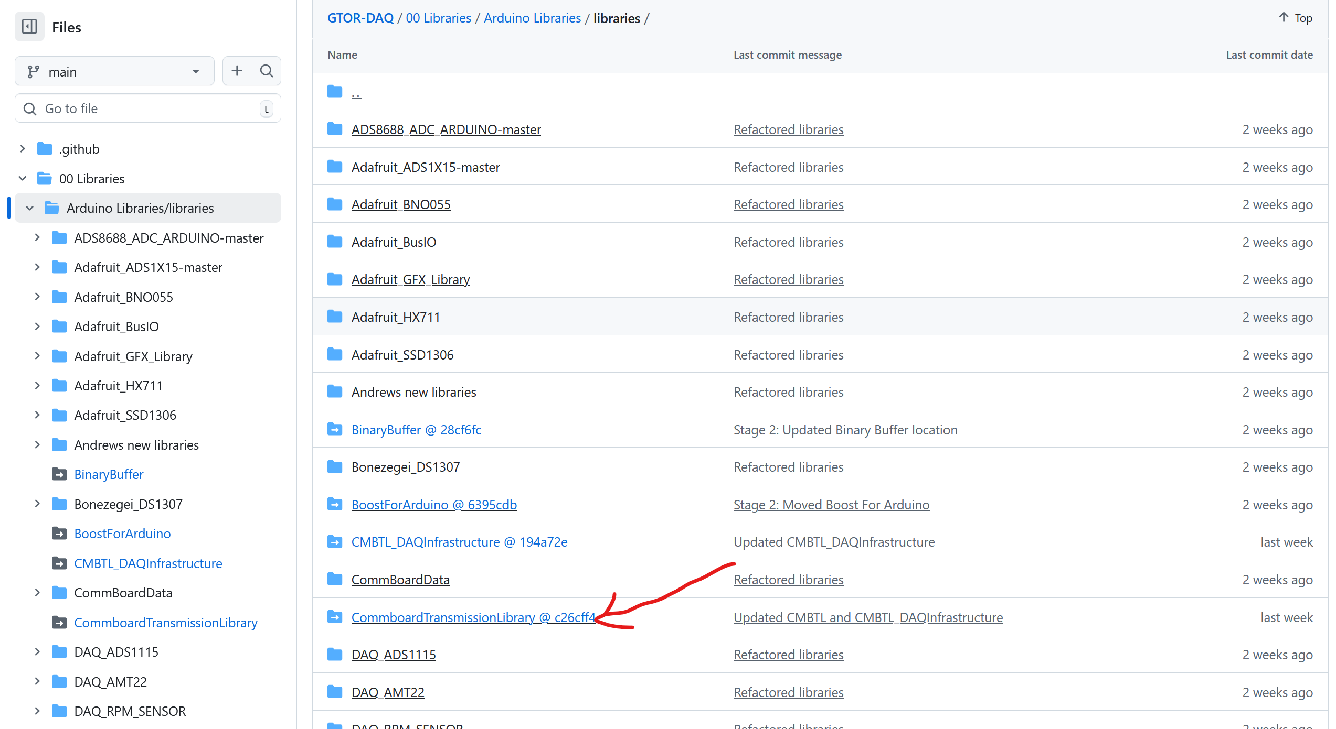
Base Infrastructure (Very generic)

Slide 5
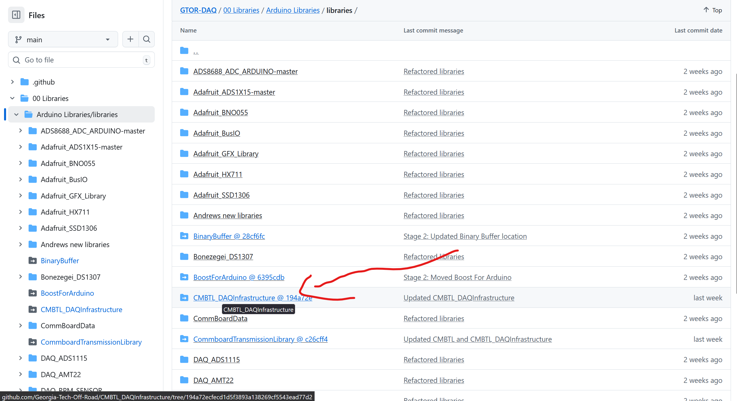
Our Sensor Suite (Implementation)

Slide 6
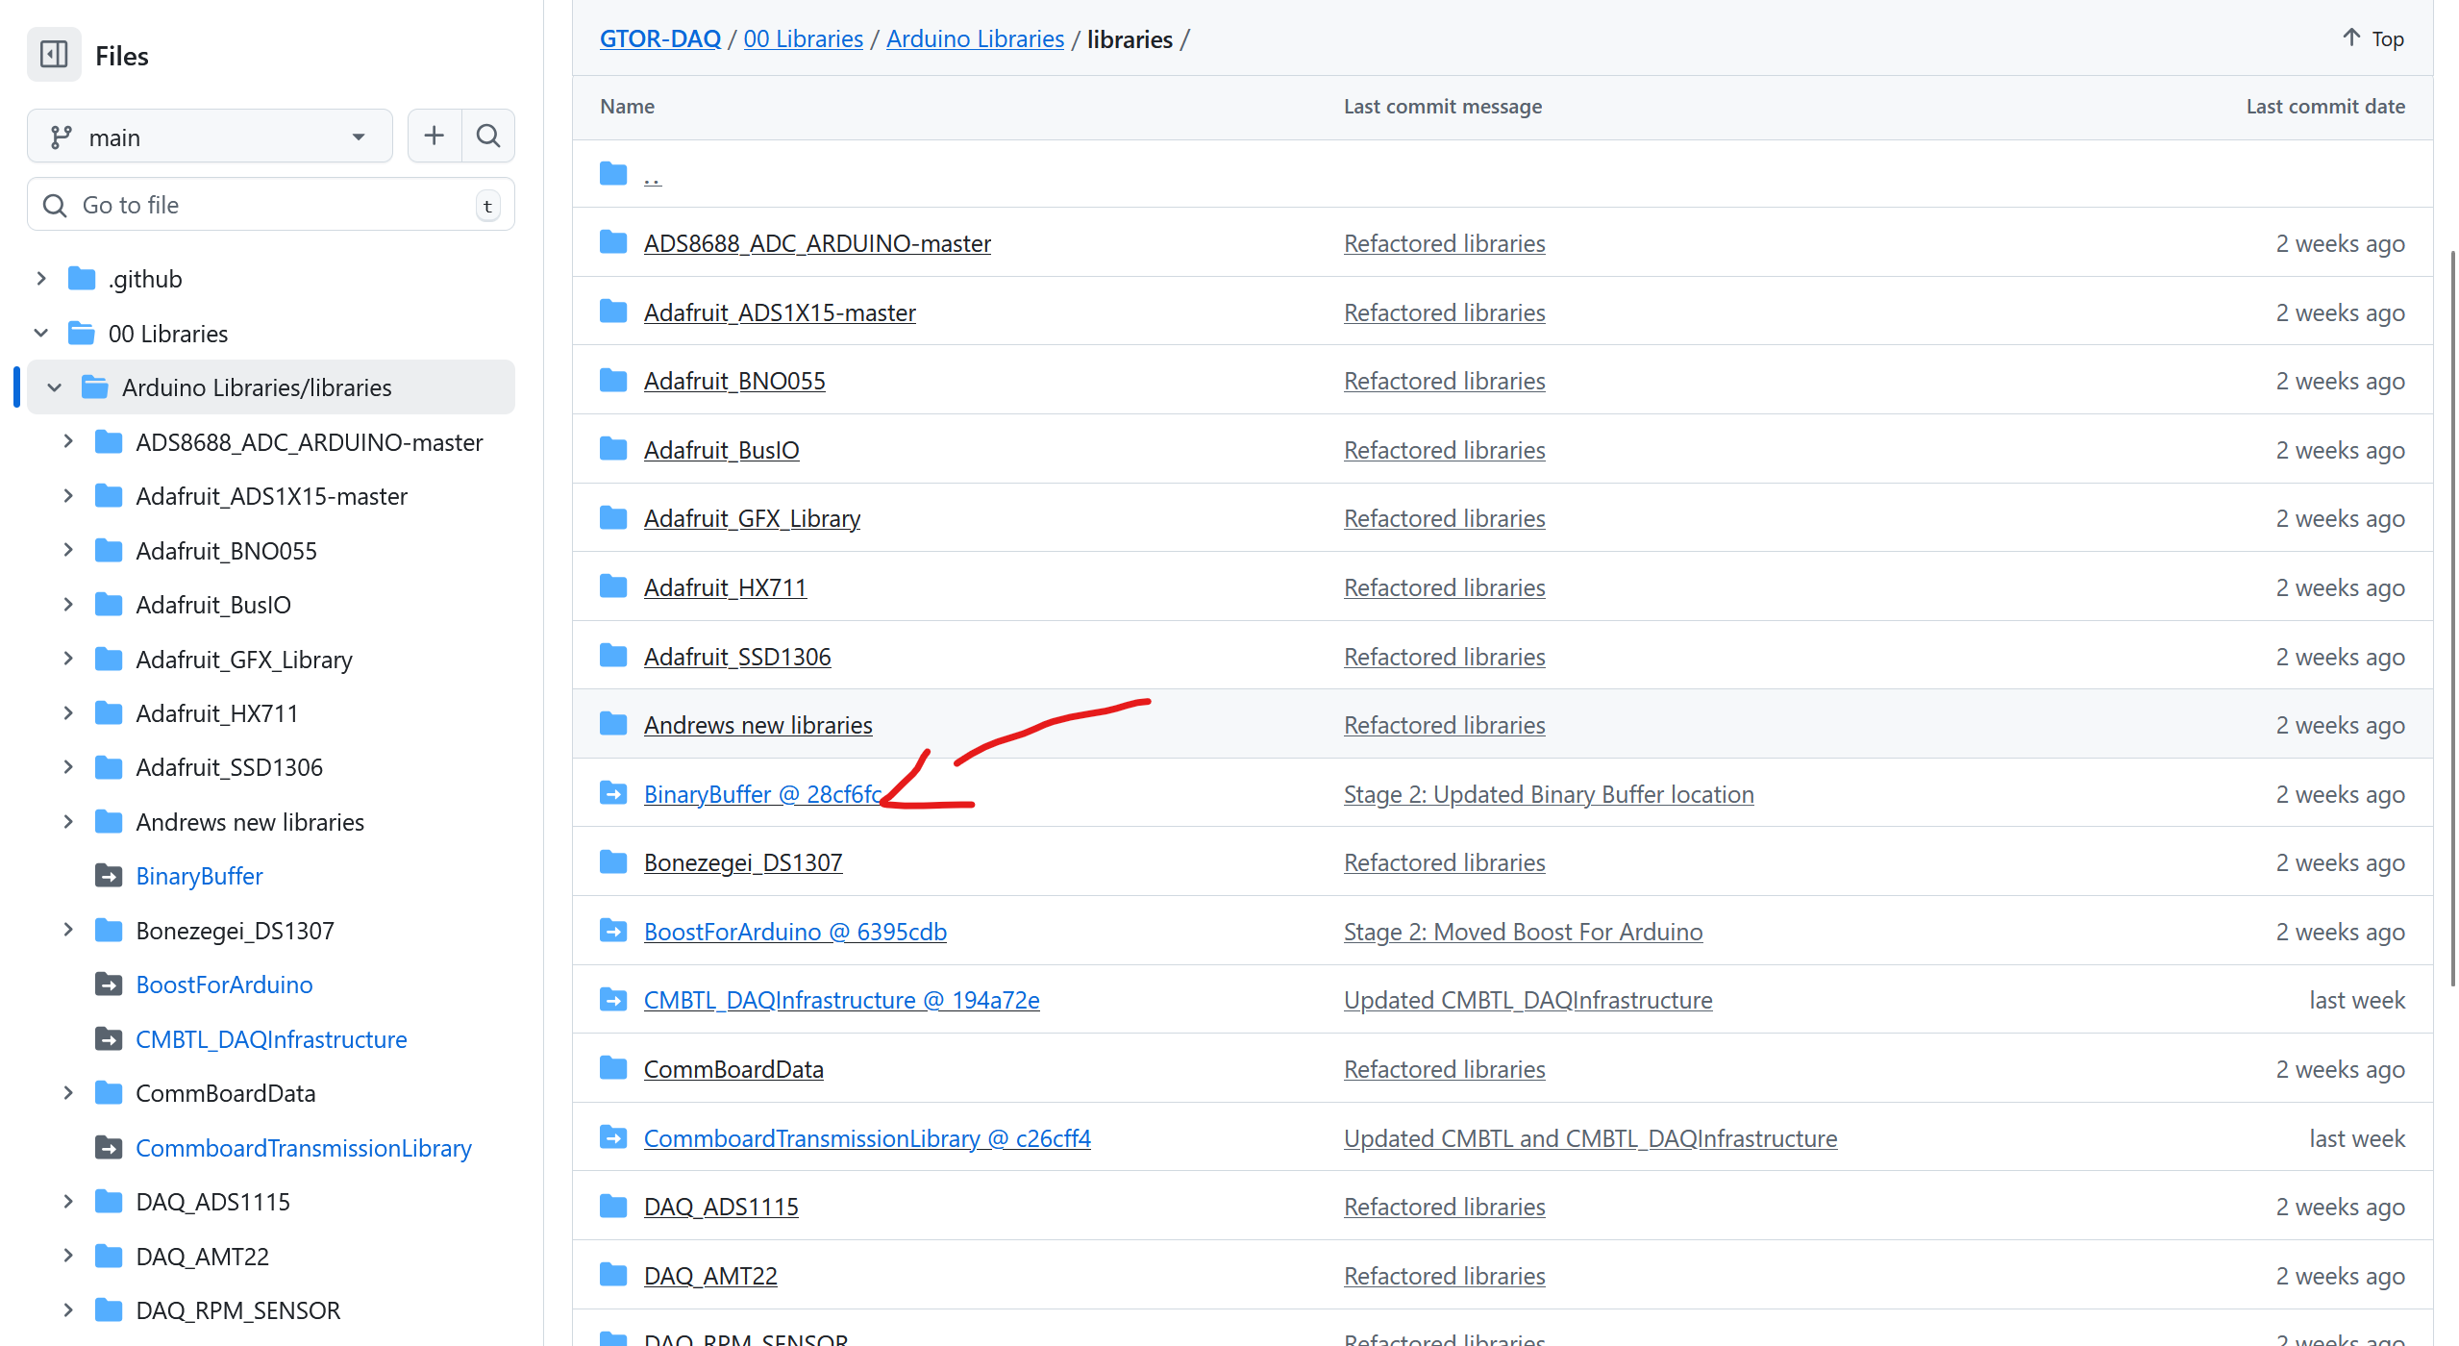
Binary Buffer -Dependency

Slide 7
Step 1: Understand how to interact with current sensor suite

Slide 8
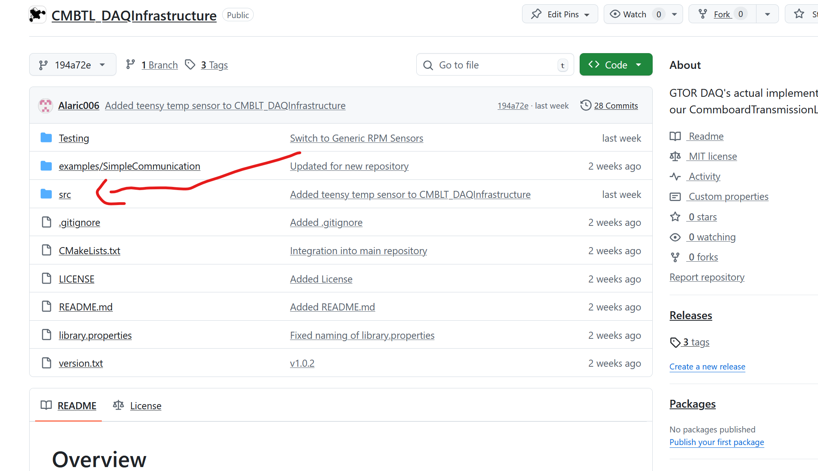
CMBTL_DAQInfrastructure
Most Arduino libraries use src/ as their main code directory

Slide 9
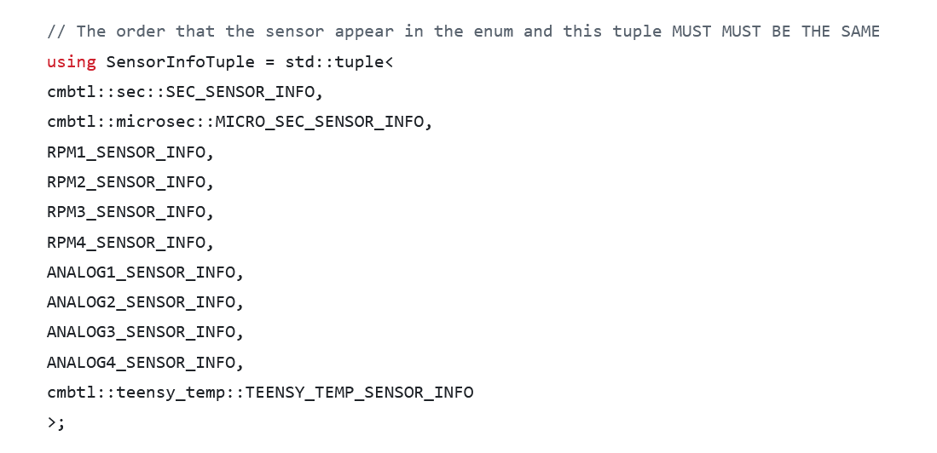
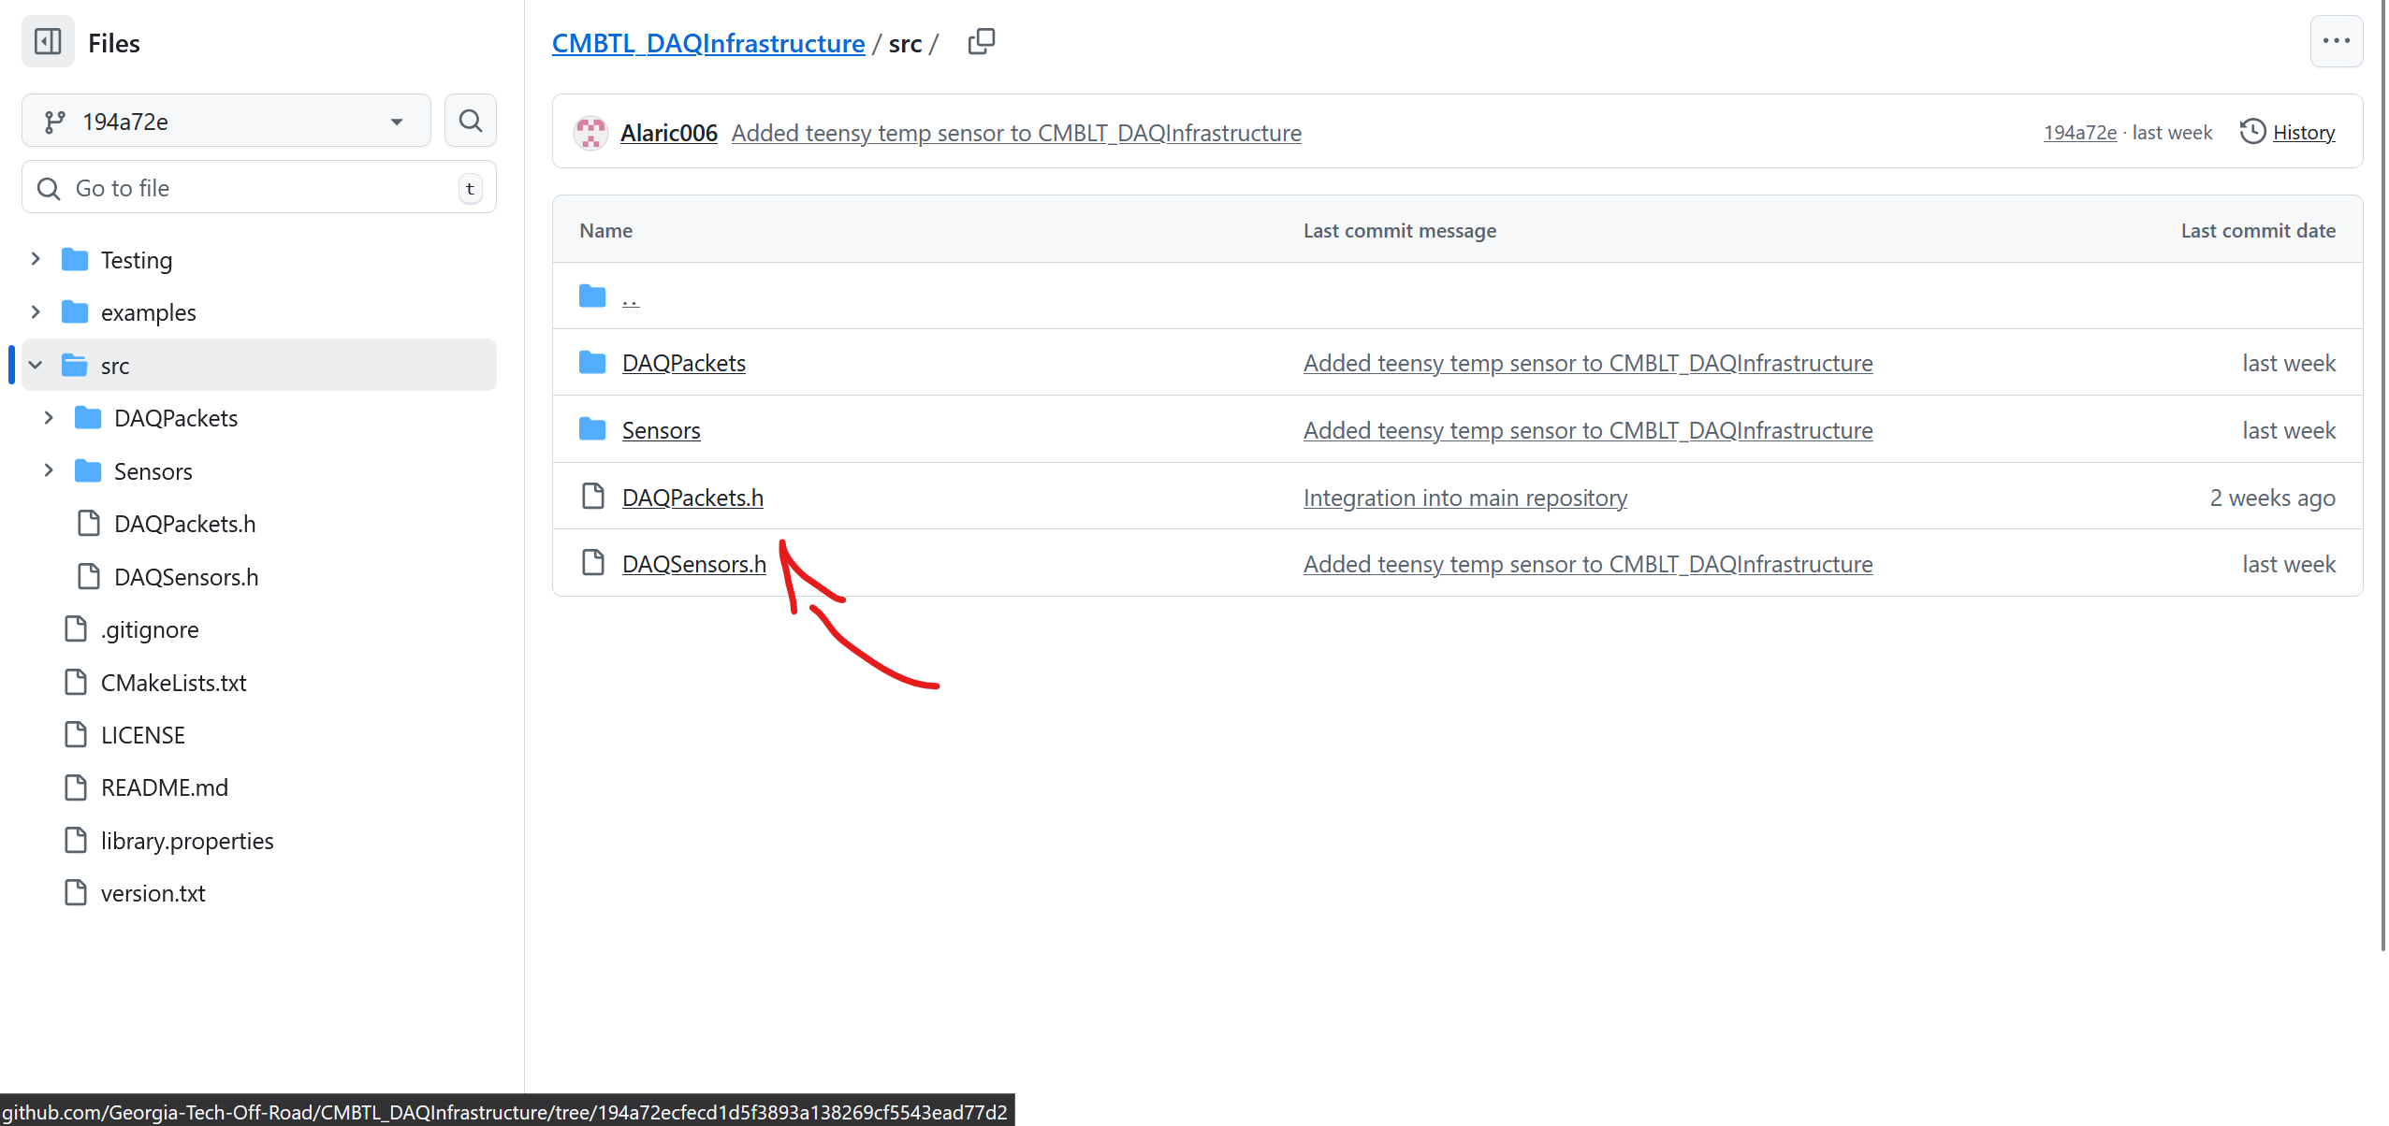
Define Sensor Suite
Tuple of our sensors

Slide 10
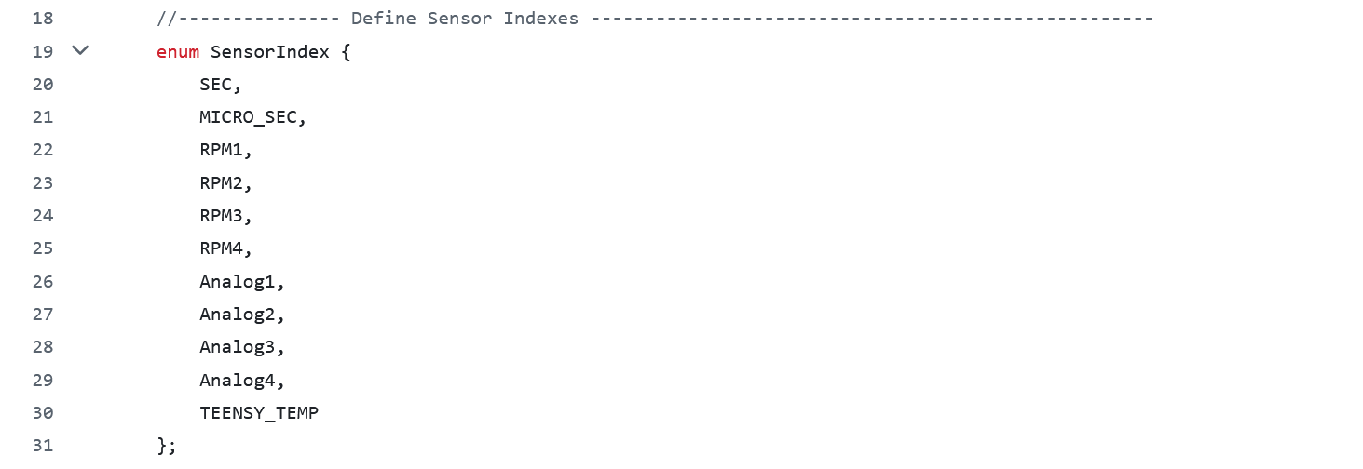
Indices for Sensors

Slide 11

Generate Functions Based on Sensors in Tuple

Slide 12
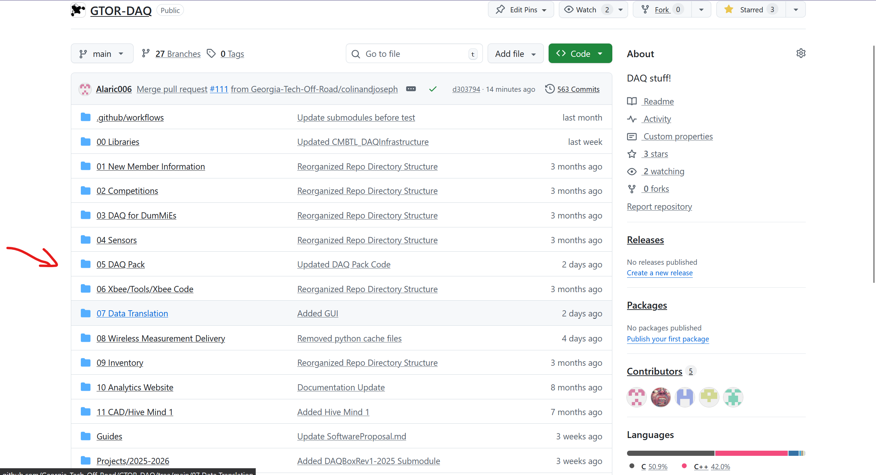
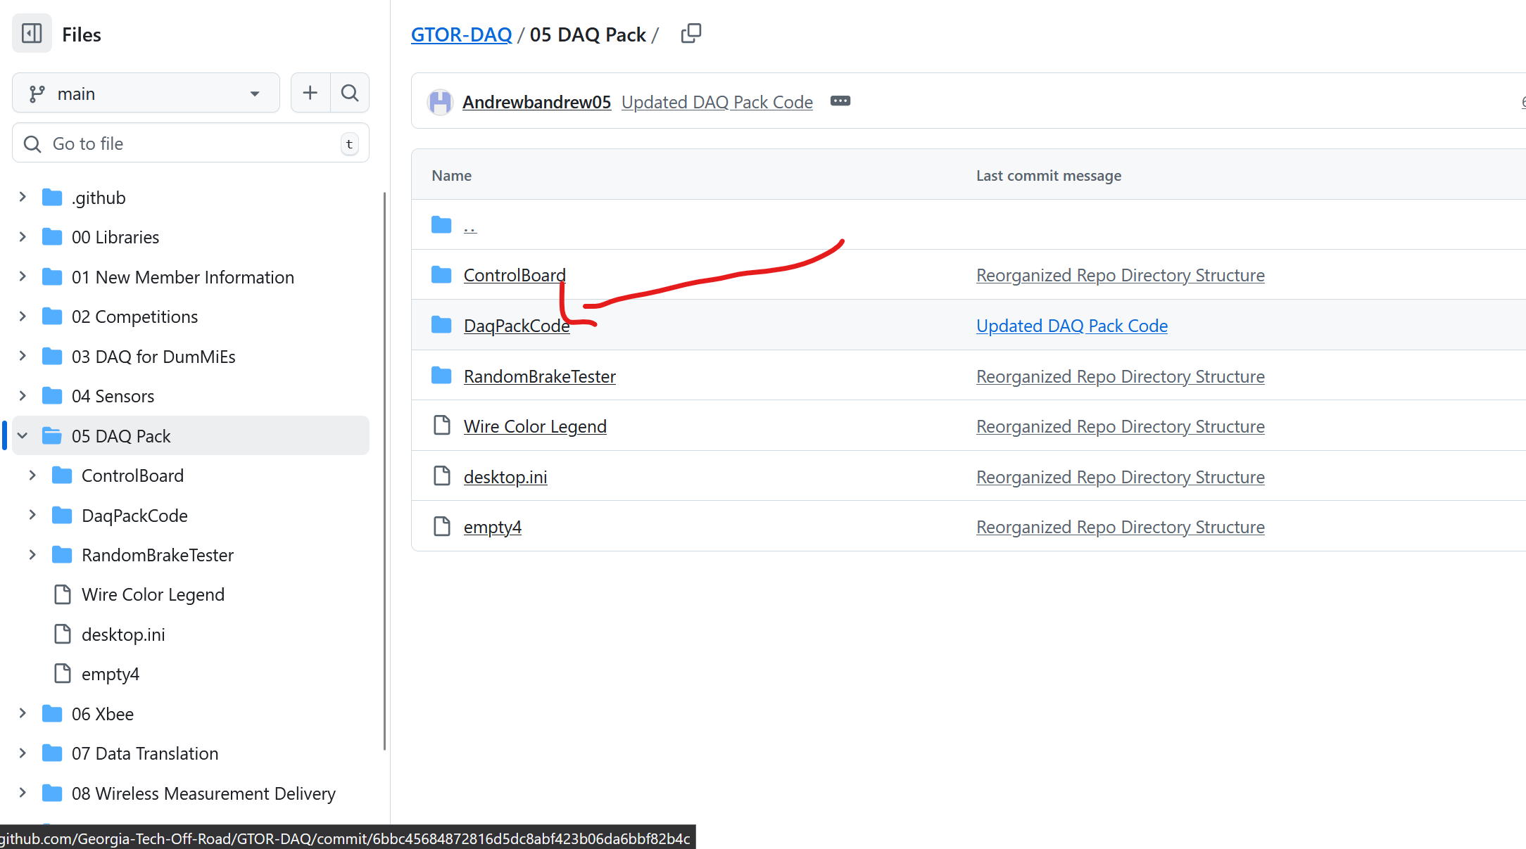
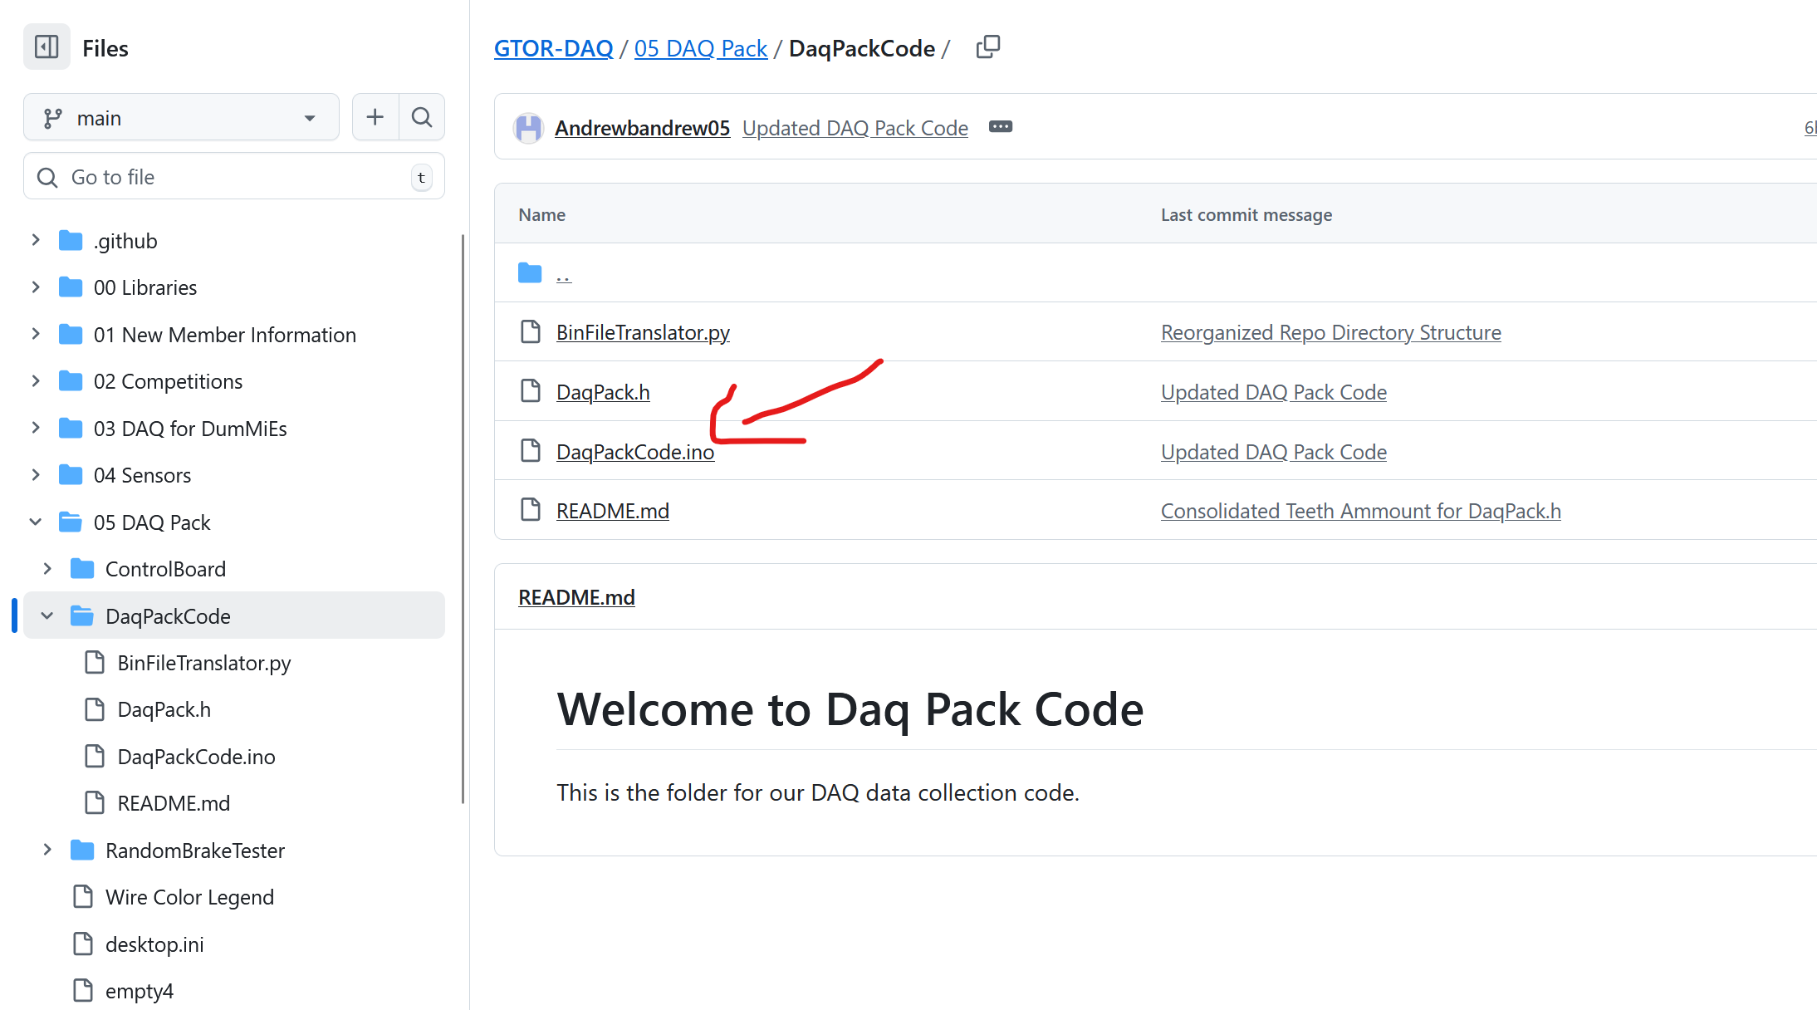
Let’s See This is Practice

Slide 13
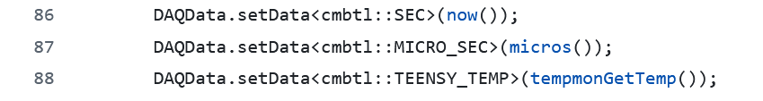
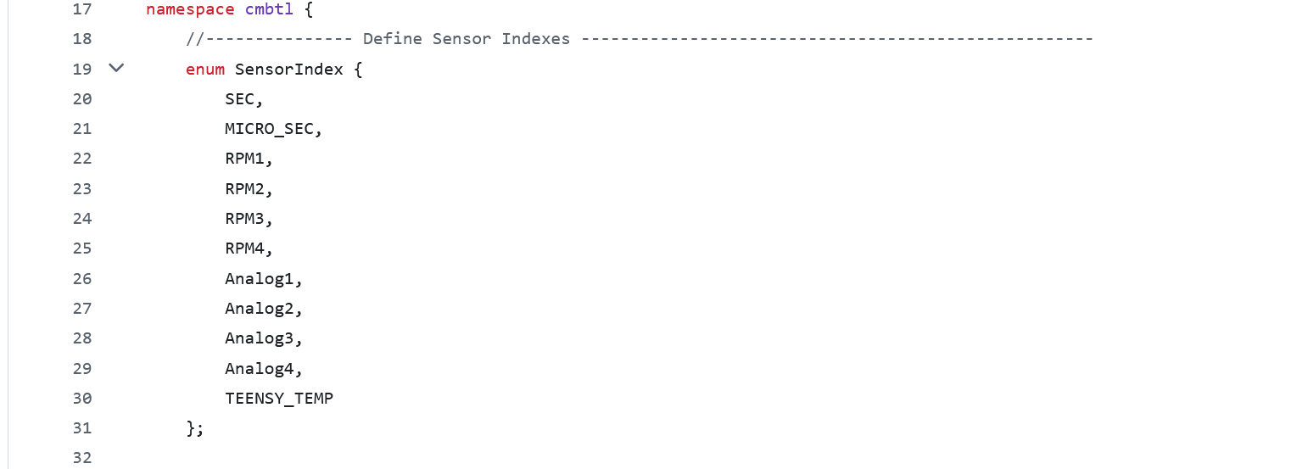
Seem familiar?

Slide 14
Retrieving Data
One way to doing this

Slide 15
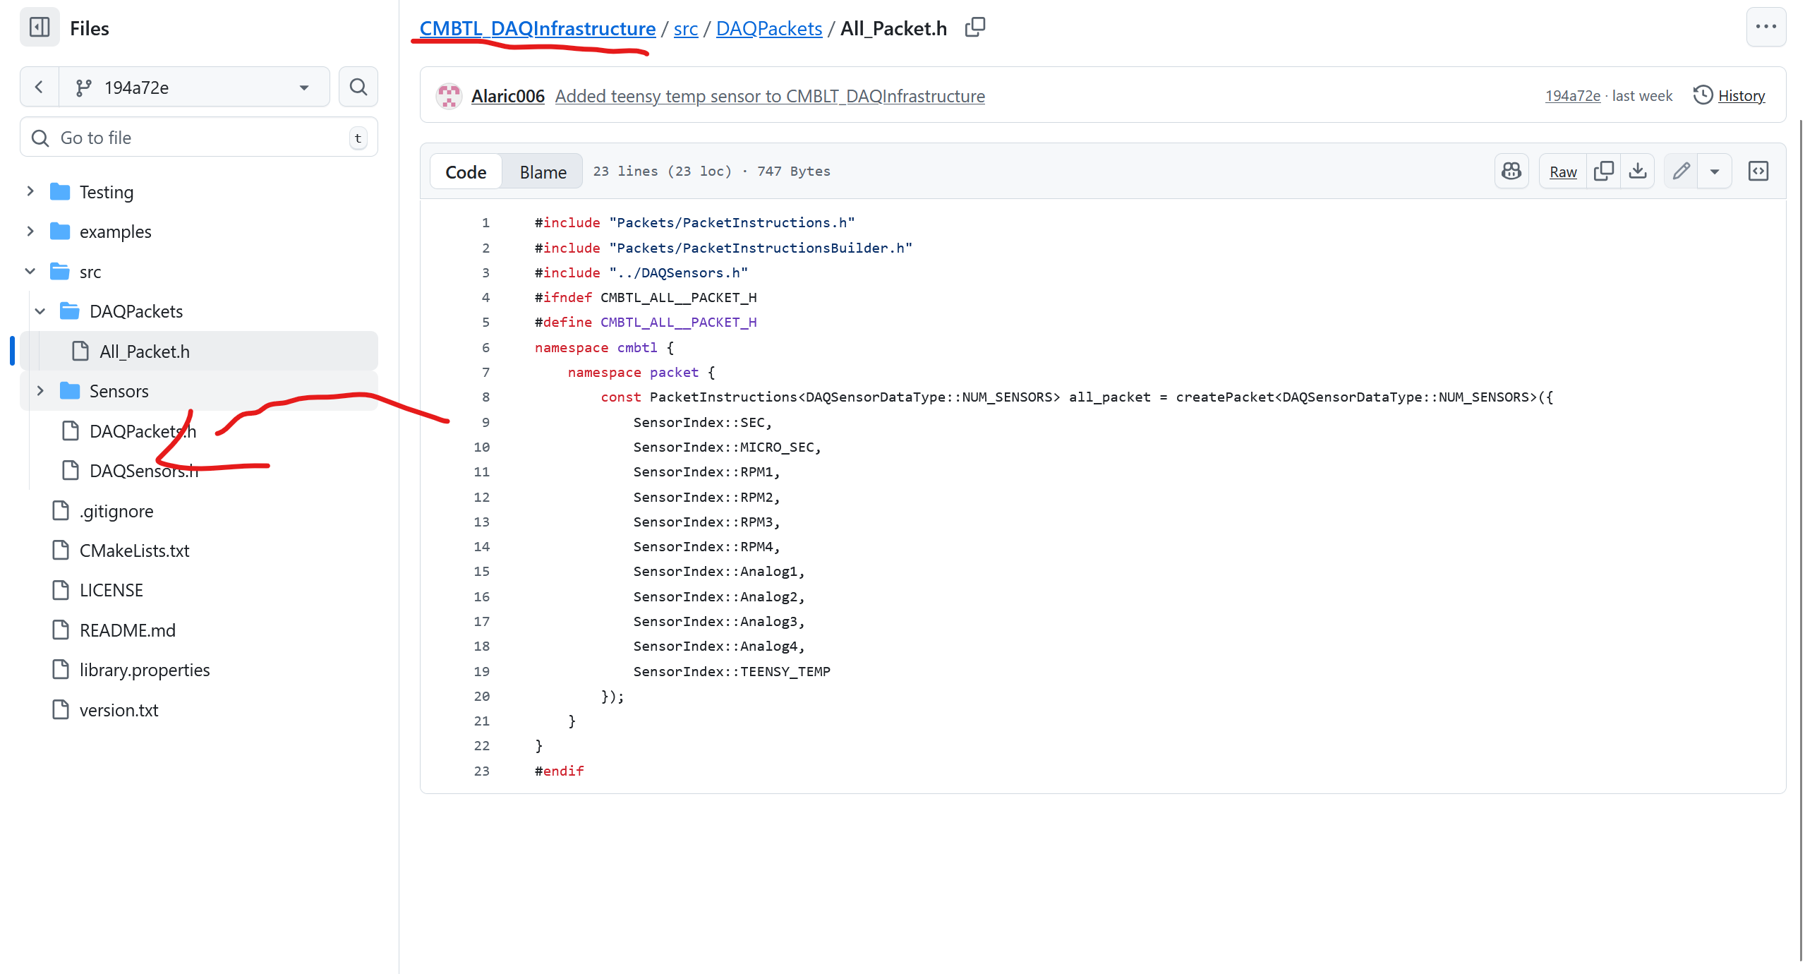
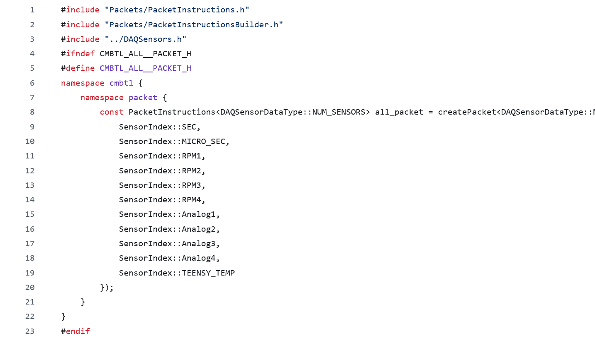
What about DAQ_Packets.h?

